Slide 1
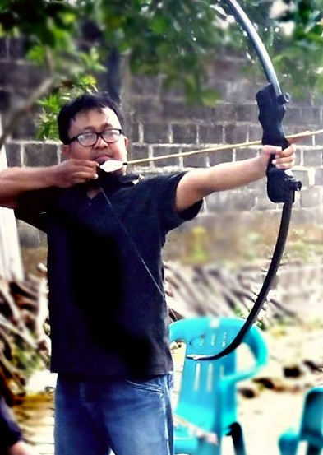
Introduction to Deep Learning
Deep Learning
Dr. Kumara Ari Yuana, ST., MT.

Slide 2
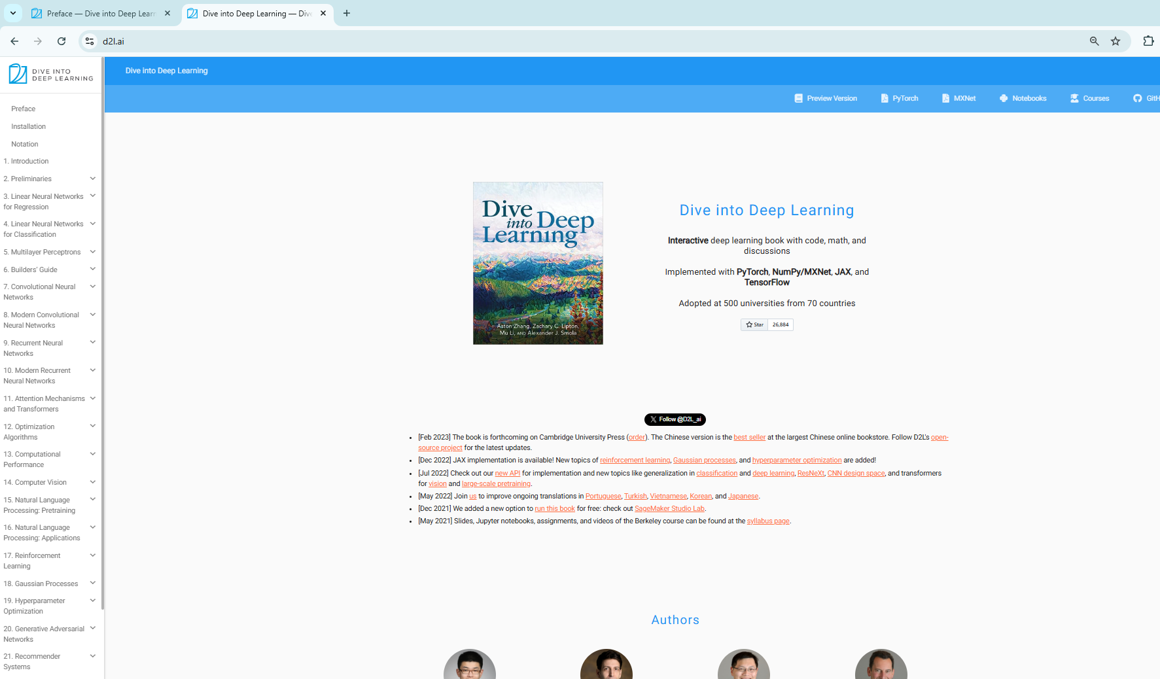
The Reference Book

Slide 3
Master Program Syllabus: Deep Learning (1)
Course Description
This course provides an in-depth understanding of deep learning concepts, models, and applications. Students will learn both the theoretical foundations and practical implementations of state-of-the-art neural network architectures. Emphasis is placed on applying deep learning in real-world domains such as computer vision, natural language processing, reinforcement learning, and generative AI.
Course Objectives
By the end of this course, students will be able to:
  Understand the mathematical and theoretical foundations of deep learning.
  Implement and train deep neural networks using modern frameworks (TensorFlow, PyTorch).
  Analyze and optimize models for performance and generalization.
  Apply deep learning techniques to solve real-world problems.
  Critically evaluate recent research papers in deep learning.
Prerequisites
  Linear Algebra, Probability & Statistics
  Calculus & Optimization Basics
  Programming in Python
  Basic Machine Learning

Slide 4
Master Program Syllabus: Deep Learning (2)
Introduction to Deep Learning
  History and motivation
  Neural networks vs. traditional ML
  Overview of deep learning applications
Mathematical Foundations (Task #1: Research Problem)
  Vectors, matrices, and tensors
  Probability review (Bayes rule, distributions)
  Gradient-based optimization
Fundamentals of Neural Networks
  Perceptrons, activation functions
  Forward and backward propagation
  Loss functions
Training Deep Networks
  Gradient Descent, SGD, Momentum, Adam
  Weight initialization
  Regularization (dropout, L2, batch norm)

Slide 5
Master Program Syllabus: Deep Learning (3)
5. Convolutional Neural Networks (CNNs) (Task #2:
Data Preprocessing)
  Convolution and pooling
  Architectures: LeNet, AlexNet, VGG, ResNet
  Applications in image classification & detection
6. Sequence Models & Recurrent Neural Networks
(RNNs)
  RNN basics, vanishing gradients
  LSTM, GRU
  Applications in NLP and time series
7. Attention Mechanisms & Transformers
  Seq2Seq models
  Self-attention & Transformer architecture
  BERT, GPT models
8. Midterm Exam / Project Proposal

Slide 6
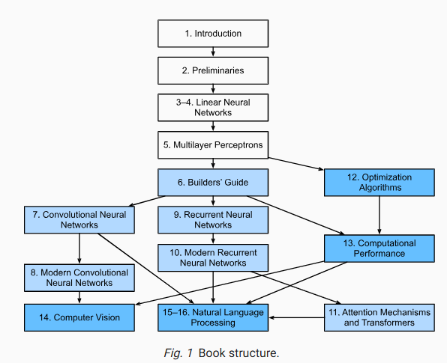
Big Picture

Slide 7
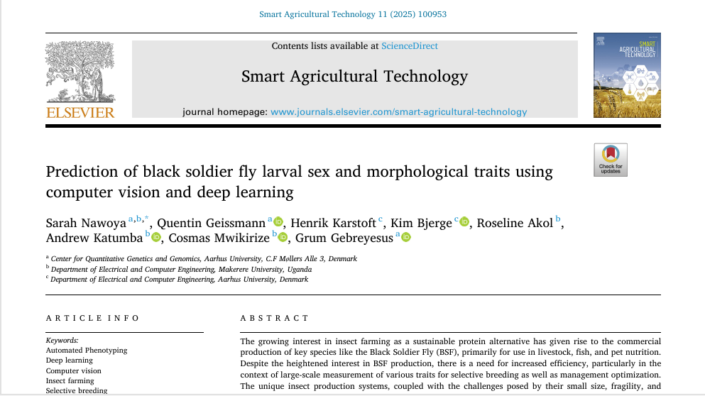
Benchmark example of Computer Vision

Slide 8
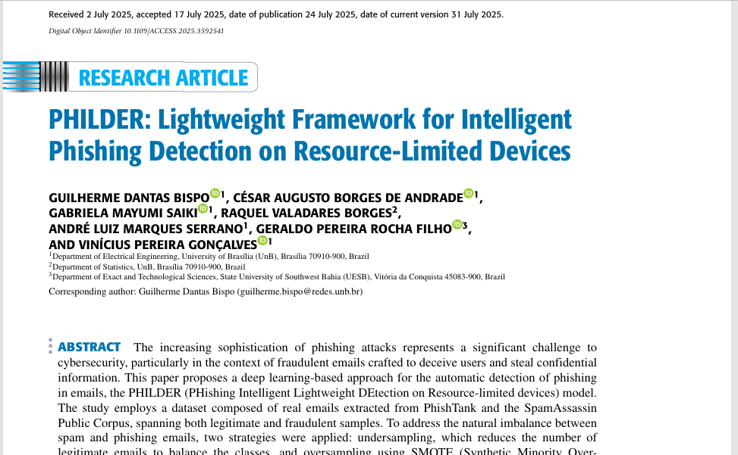
Benchmark example of Natural Language Processing

